Slide 1

A cybersecurity game

Slide 2




Pause the video here and think about your answer, press play when ready.
Which adversary do you think did it?
Cybercrime
Nation Sponsored
Hacktivist

Slide 3



What is Threat Intelligence?
Learn about adversaries…
…and share knowledge with public/private sector partners
Track adversaries over time…
…to understand the changing threat landscape
Implement defenses…
…and work with product teams to protect customers
A cybersecurity game

Slide 4
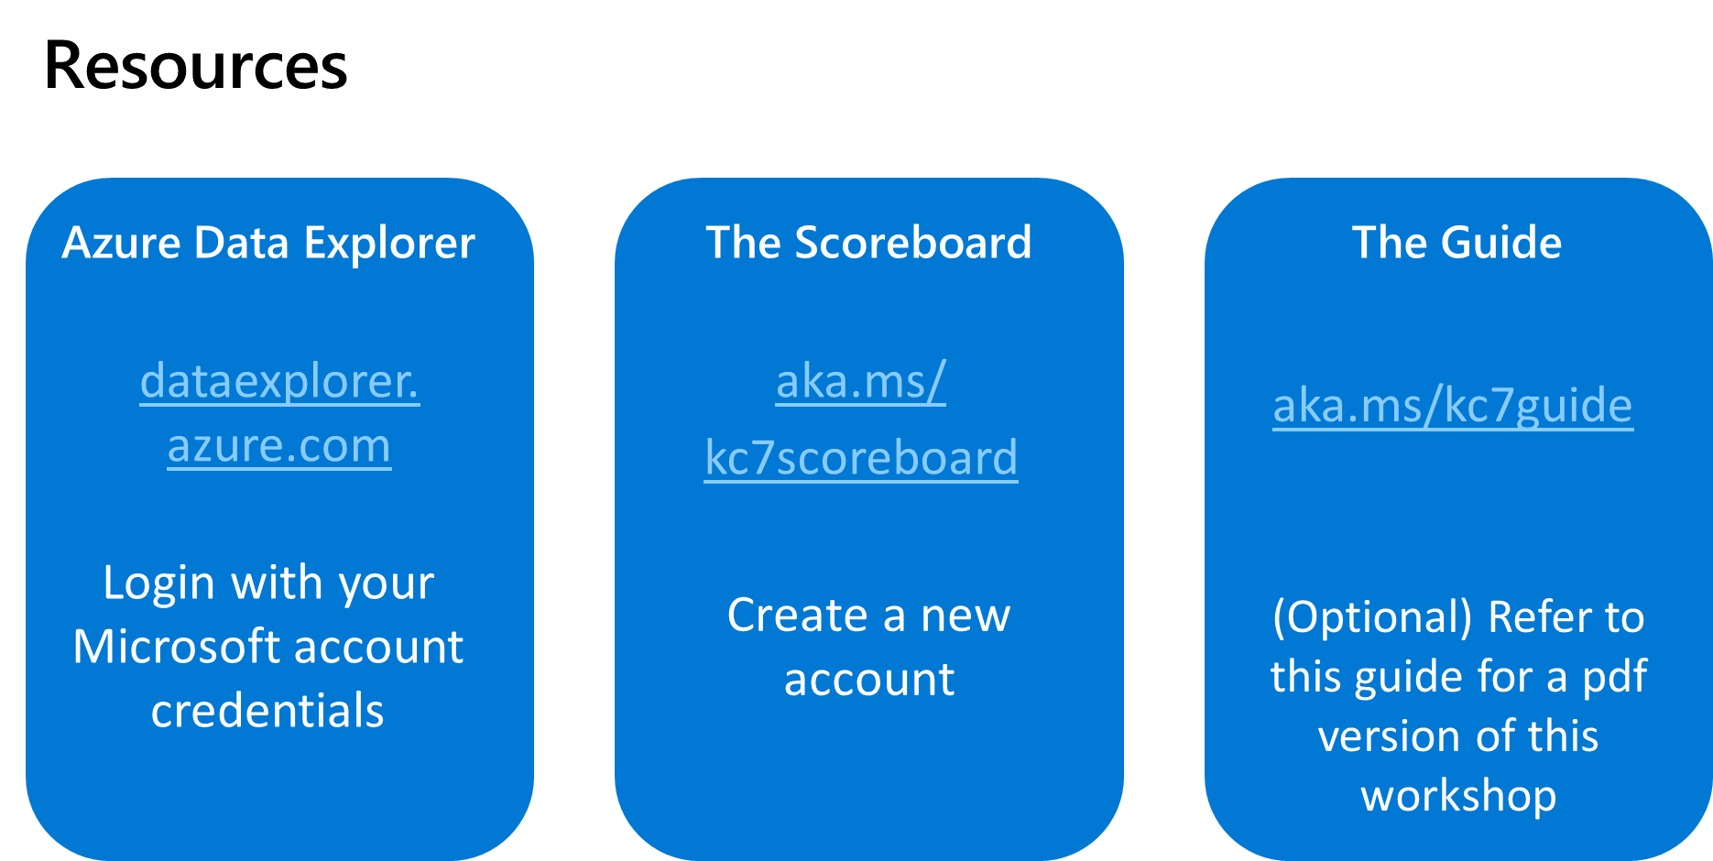

Slide 5
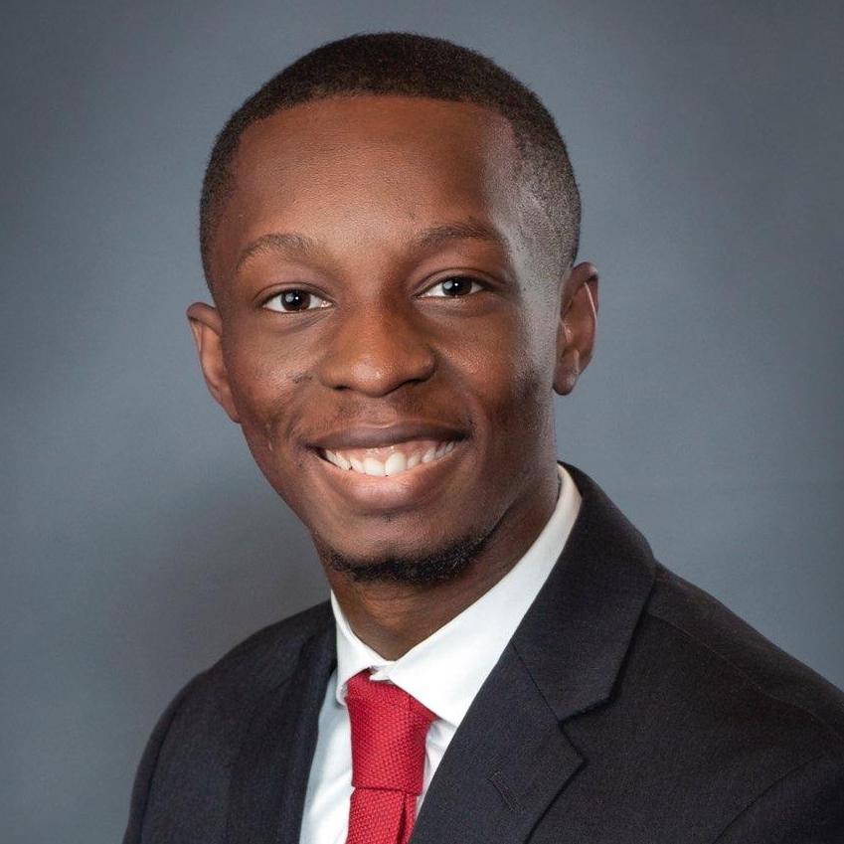


Hello!
I am Simeon Kakpovi
B.B.A Computer Systems – Howard University
MPhil. Technology – University of Cambridge
Senior Threat Intelligence Analyst - Microsoft

Slide 6
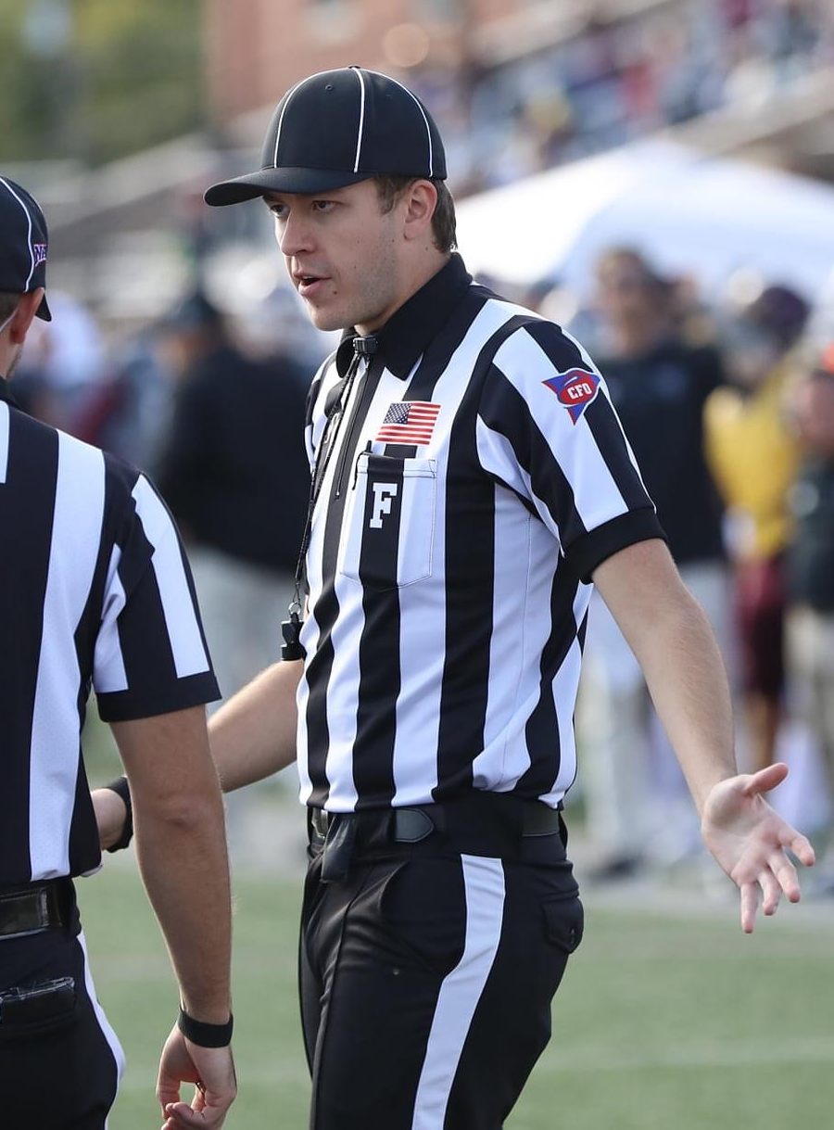

Hello!
I am Greg Schloemer
B.S. Computer Engineering – University of Kentucky
Threat Intelligence Analyst - Microsoft

Slide 7
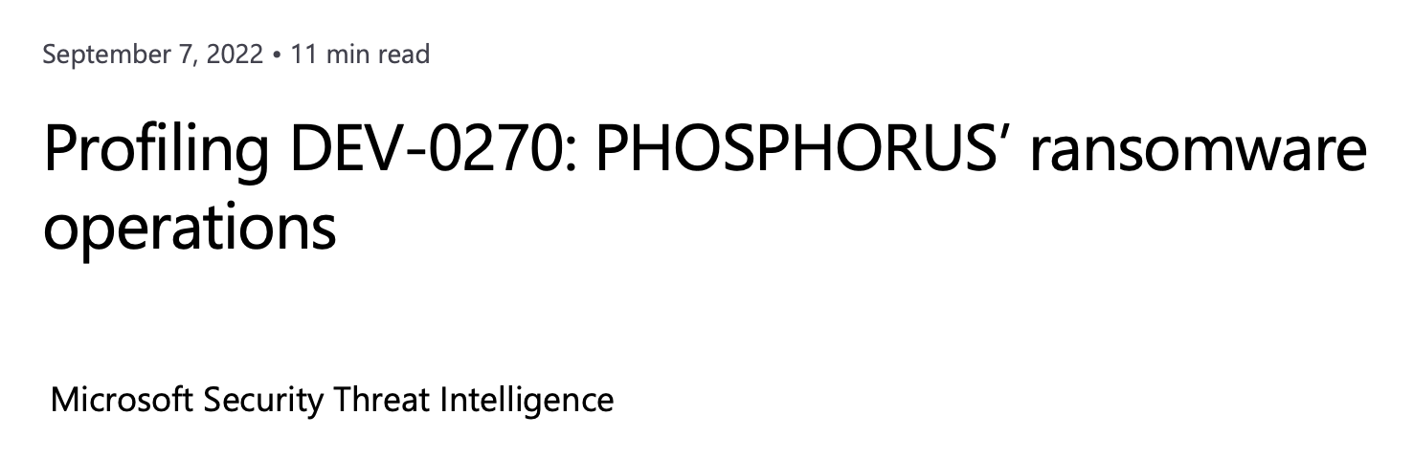
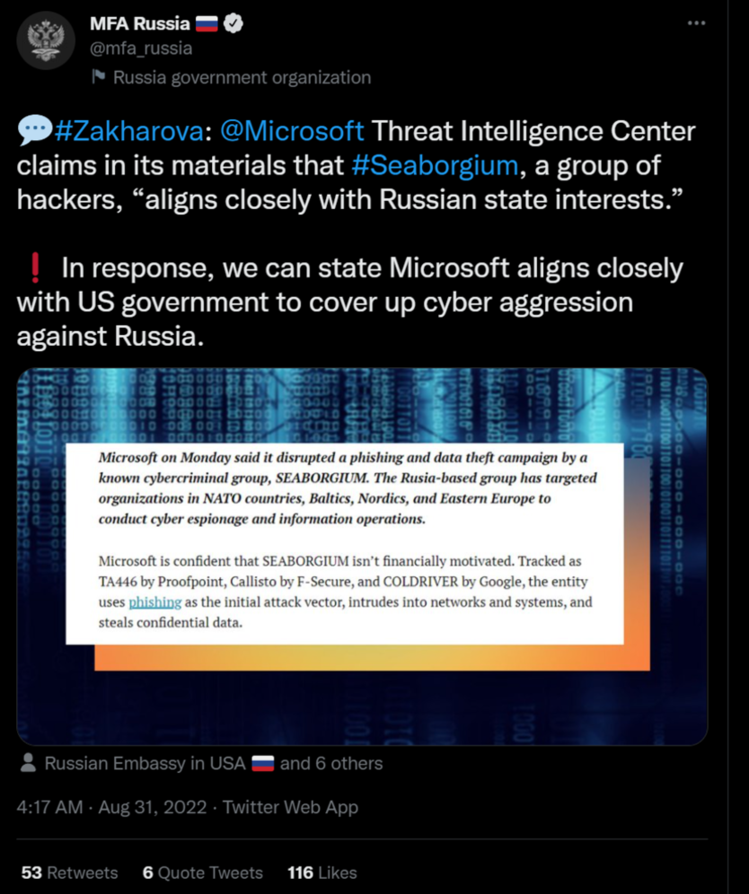
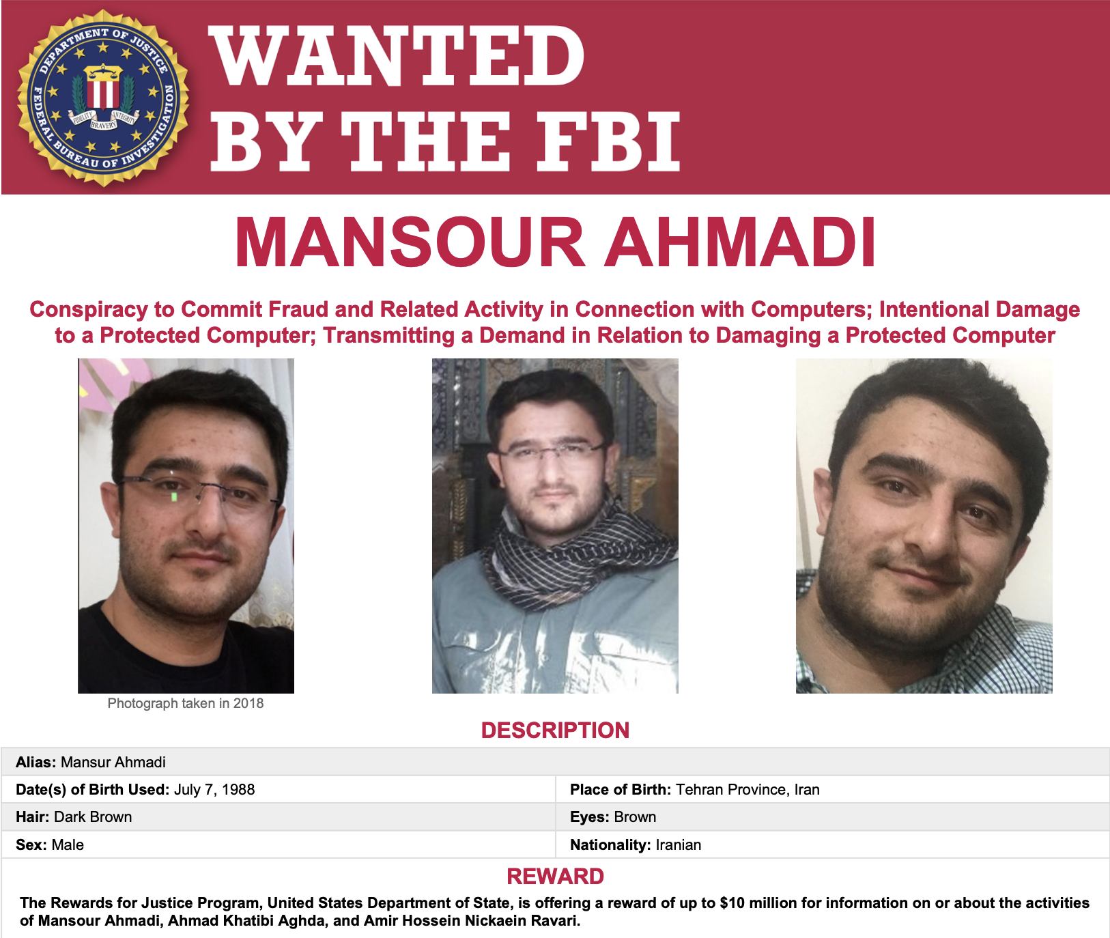
What is a Threat Intelligence Analyst?

Slide 8
⚠️ Quick Disclaimer!
We work for Microsoft, a 🇺🇸-based company
Our job is to protect our customers
We have blind spots and biases

Slide 9
Why?
1
Why would anyone want to “hack”?

Slide 10
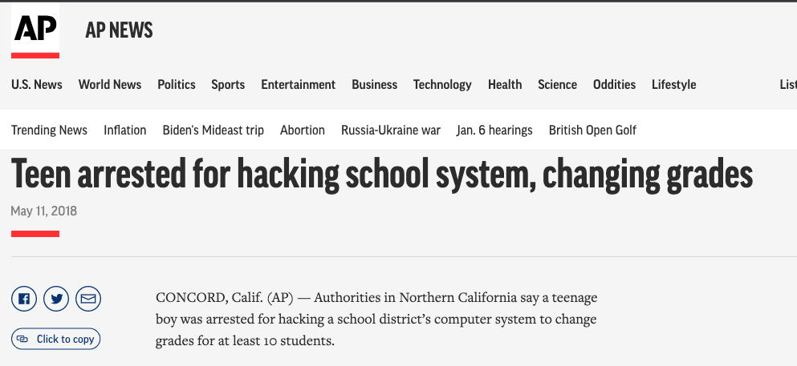

Slide 11
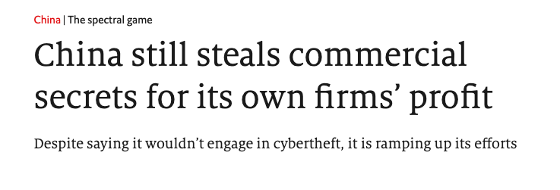
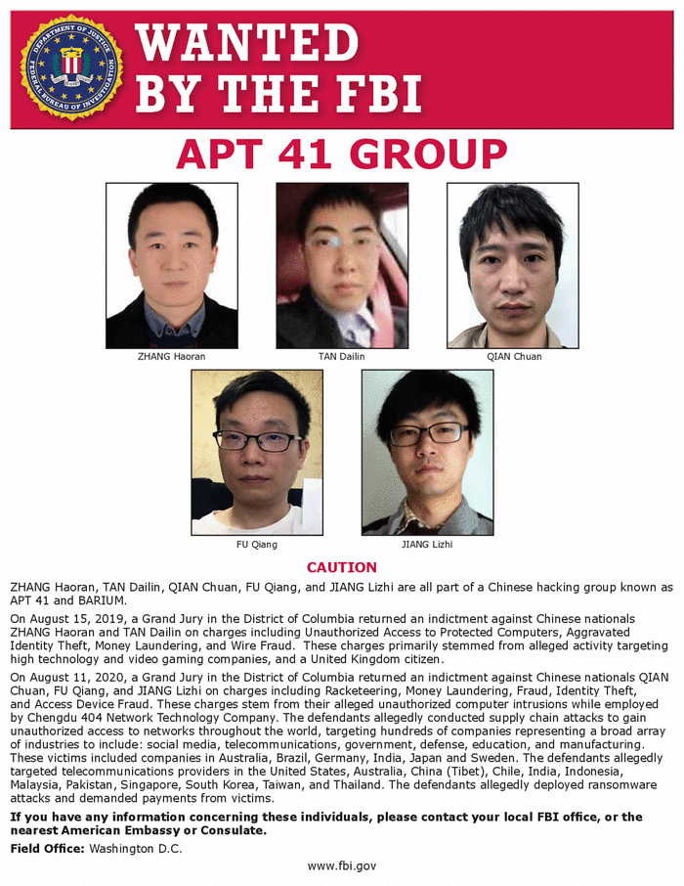
Notes:
https://www.economist.com/china/2021/11/11/china-still-steals-commercial-secrets-for-its-own-firms-profit

Slide 12
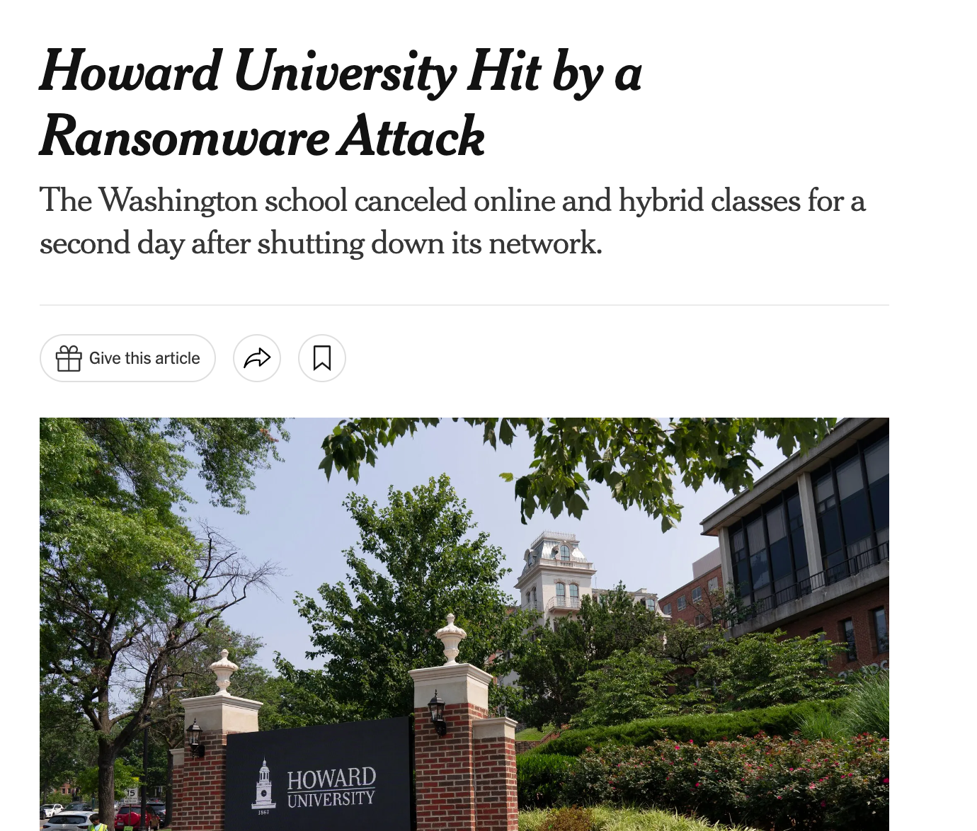
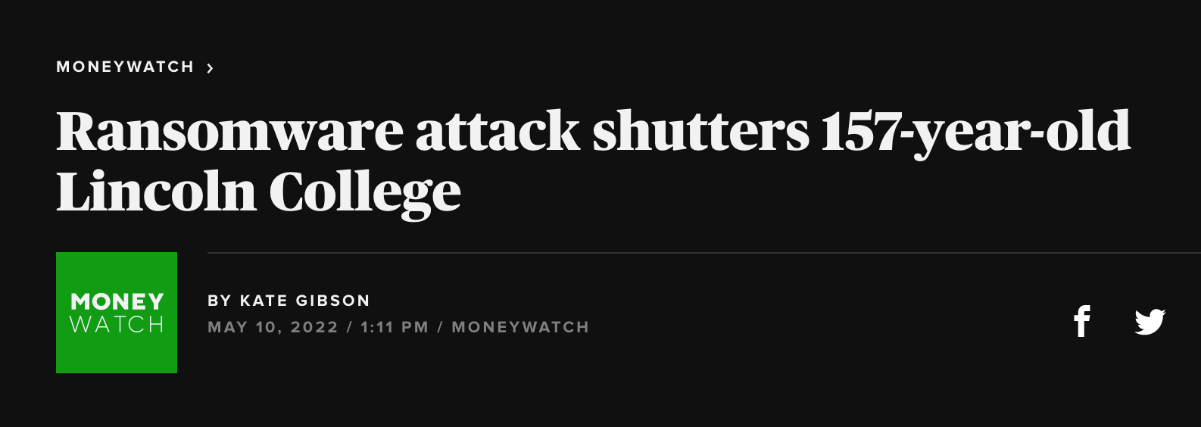

Slide 13
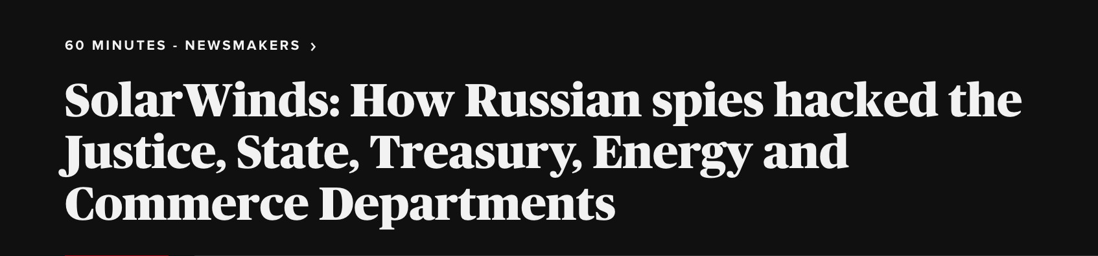
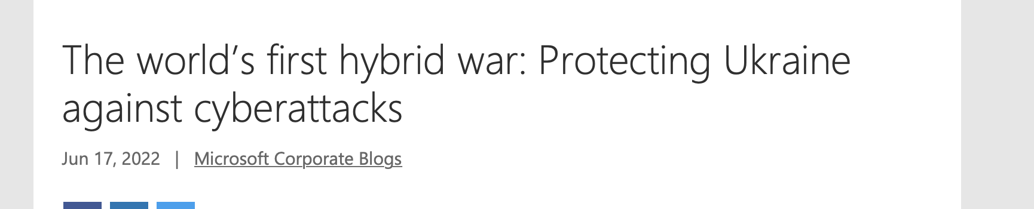
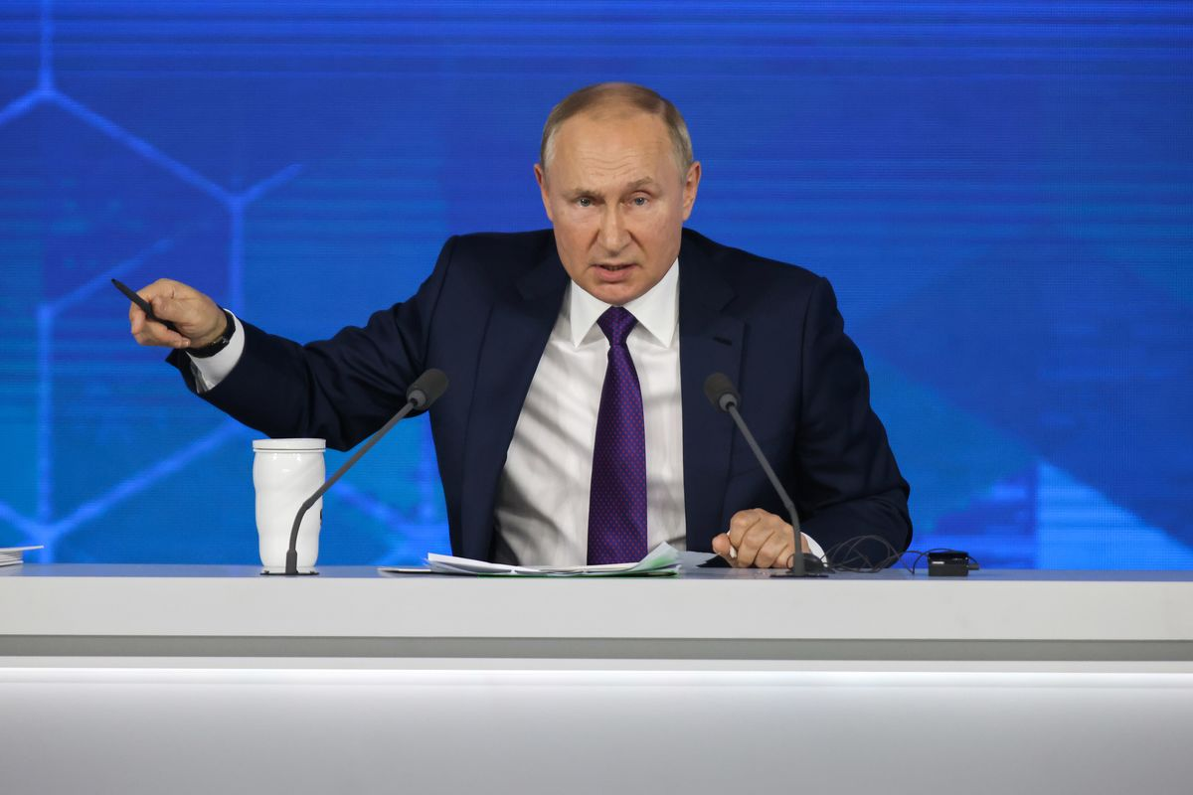
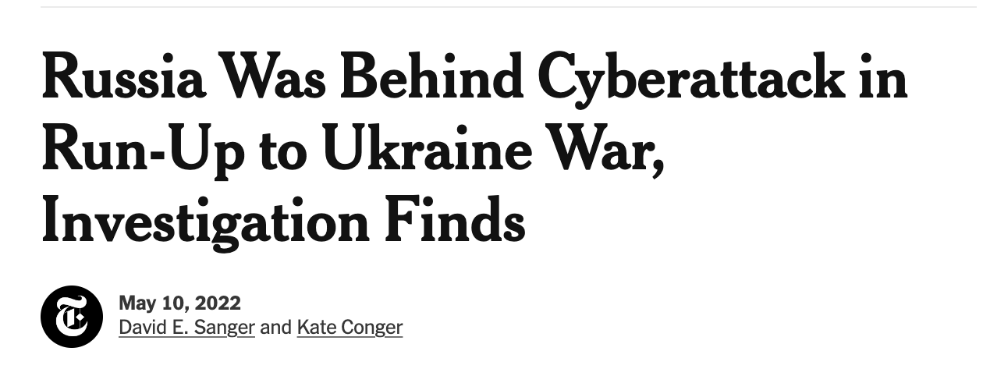

Slide 14
Who?
2
Who is doing all this hacking?

Slide 15

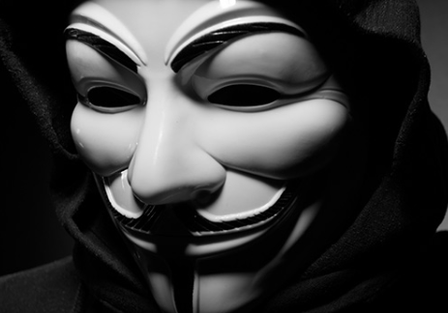
Hacktivist
Hacking to spread idealism
Political or Social Change
E.g. Cult of the dead cow / Anonymous

Slide 16
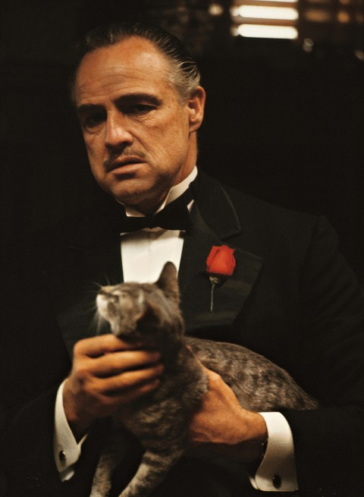

Cybercrime
Motivated by money
Indiscriminate targeting
Ransomware / Business Scams / Hack and Leak
Level of organization varies
Lone wolf -> Organized mafias

Slide 17
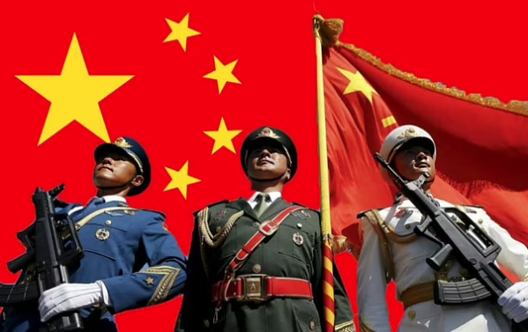
Nation Sponsored
Government sponsored or affiliated
Highly funded
Highly motivated
Selective in targeting
Long term outlook

Slide 18
What?
3
What do people do when they hack?

Slide 19

How would you rob a house?

Slide 20
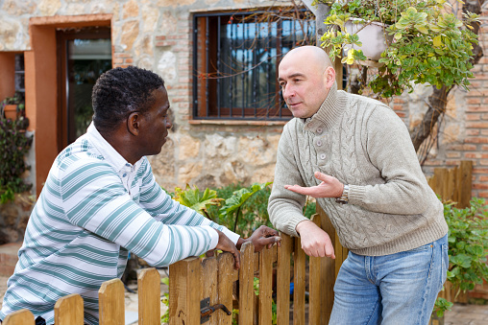
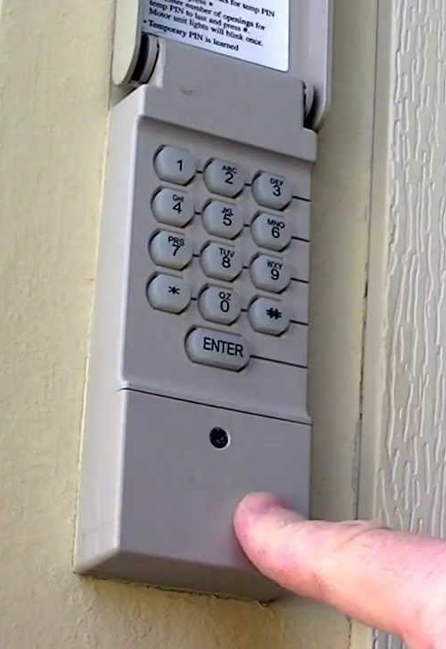
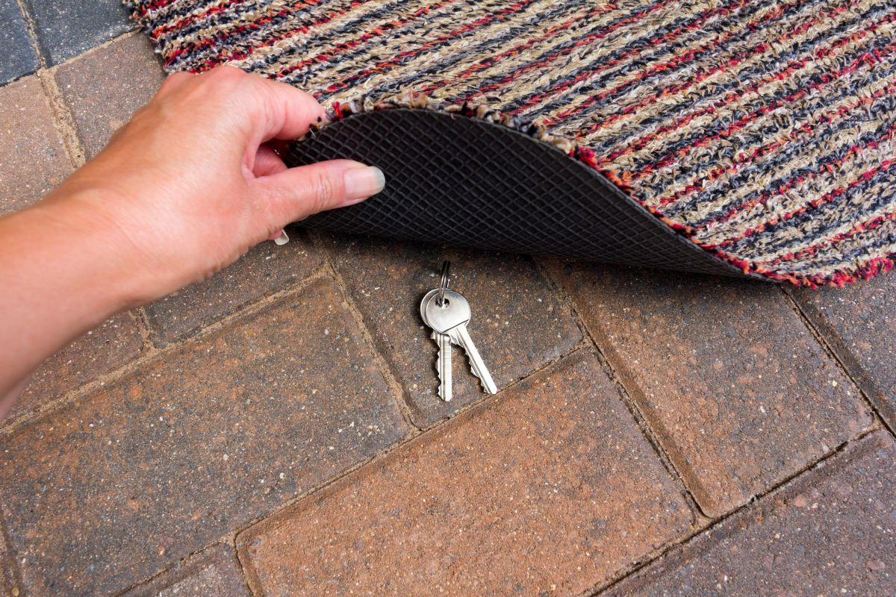

How would you rob a house?
Check for open windows
Ask neighbor for spare key?
Your “uncle and Auntie” sent you”
How about a rock?
Or hammer?
Walk in the front door
Garage door! Guess the code?
Pick the lock?
Check for key under mat
Check the back door
Pretend to be maintenance utility guy

Slide 21
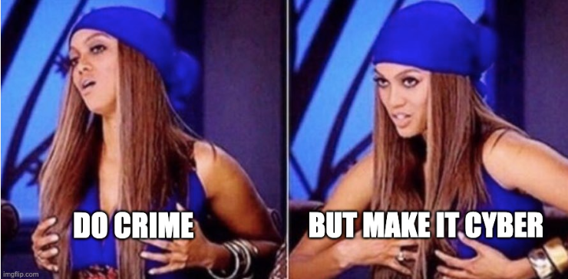

Slide 22
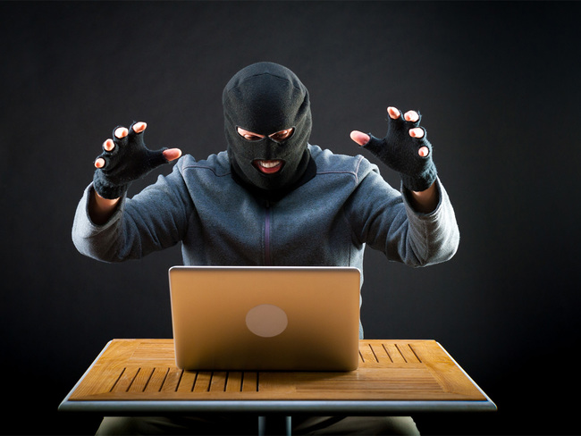


Hacker
Firewall + other protections
You + your data

Slide 23
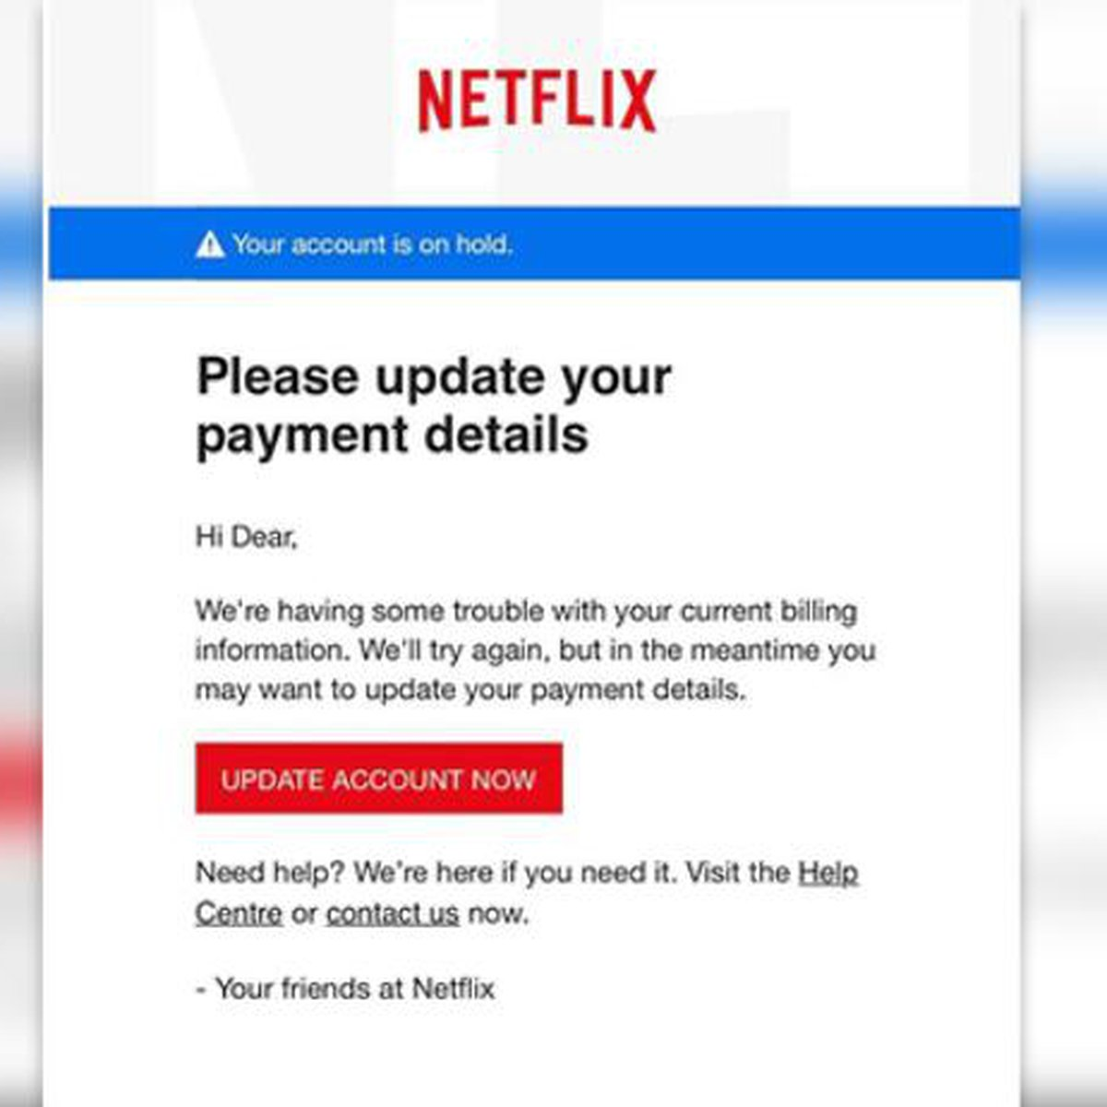
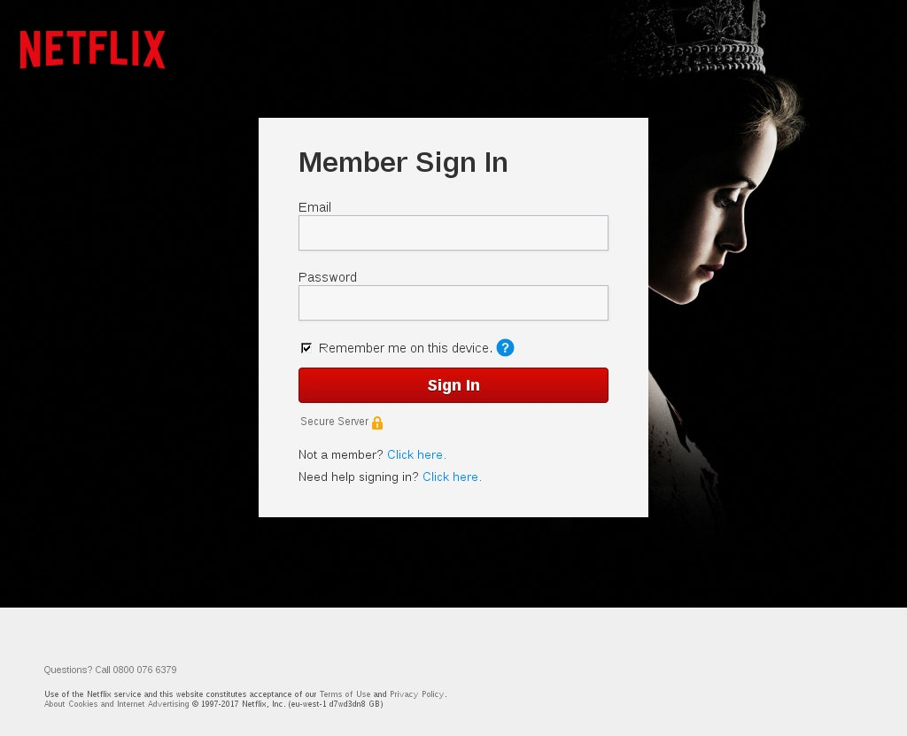
Your username + password

Slide 24


”Hey! Check out this file for me!”
Access to your computer

Slide 25

Phishing Attack
I want to get access to someone else’s information!!
Why?
Financial motivation
Corporate espionage
Abuse access for other activity
Attacker
😈

Slide 26
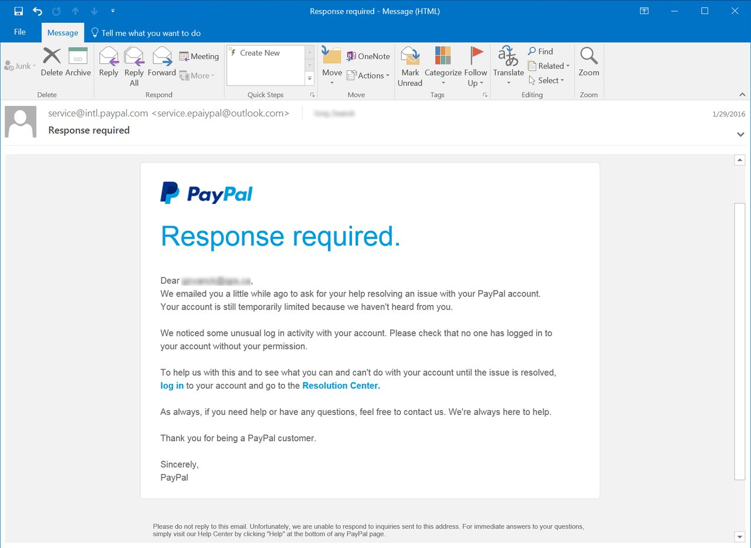
What’s in a phish?
Email spoofing
Legit-looking sender email
Mimicking reputable brand
Urgent subject line
Link to actor-controlled domain

Slide 27
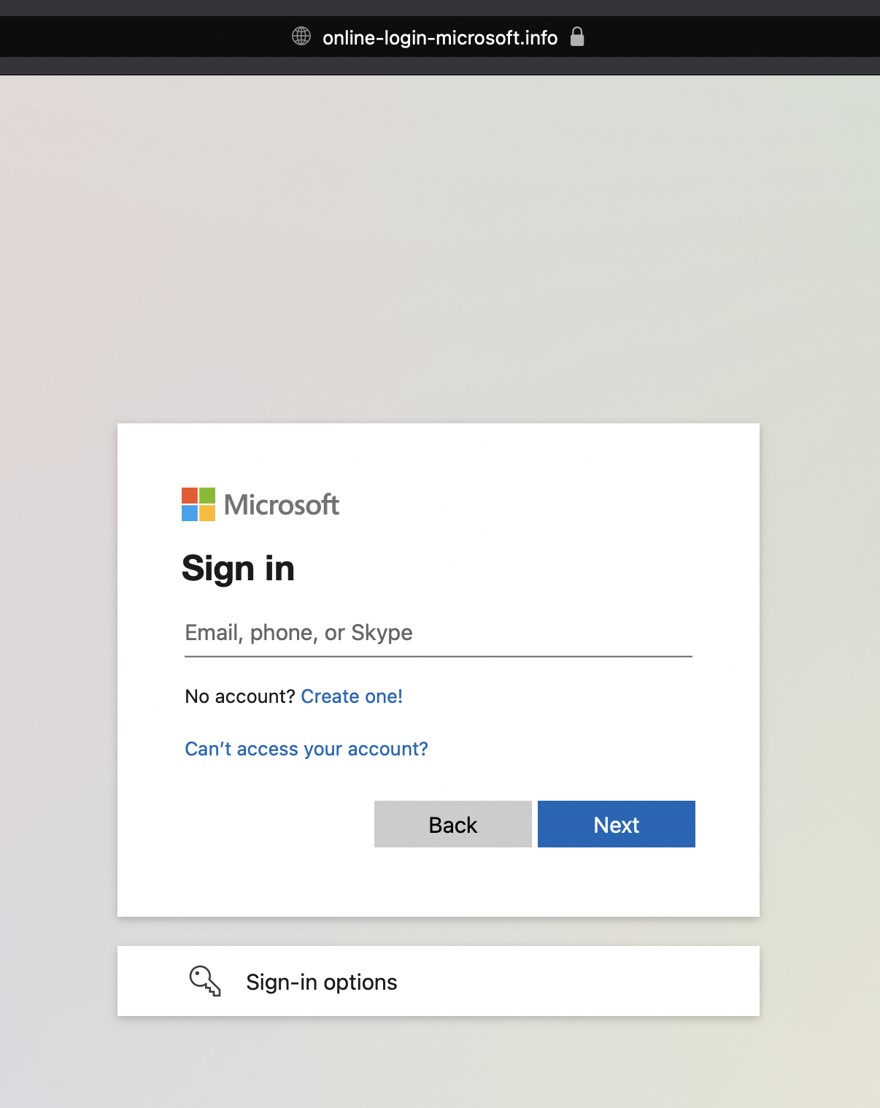
What’s in a phish?
Not the legit Microsoft login domain
User login credentials are captured

Slide 28


All about domains and IPs
The attacker gives the credential stealing page a legit-looking domain
Humans are good at reading domain names, but computers are not
Just like your street address tells your friends where you live
47.50.183.20
An IP address tells your computer where a particular website lives on the internet
online-login-microsoft.info

Slide 29
Catching Phish (How do we find bad actors?)
Attacker registers domain
Attacker sends an email
Victim clicks link
Log into user’s account
At every step of the way, security logs record a history of what the attackers are doing, so that security analysts can help keep us safe.

Slide 30
Scoreboard/Challenge Questions kc7cyber.azurewebsites.net
Azure Data Explorer (Security Logs)
dataexplorer.azure.com
Digital Packet (Walkthrough + Questions)
kc7cyber.com/go

Slide 31
Why don’t you just take the physical computer?
“

Slide 32
Thanks!
Any questions ?
You can find me at
@simandsec / skakpovi@microsoft.com
@greg_schloemer / grschloe@microsoft.com

Slide 33
Username: kc7cyber@gmail.com
Password: LetzD0Cyberz

Slide 34
https://tinyurl.com/kc7fcps

